Slide 1


Autonomous Driving Robot
Josh Wells (Jow102)

Slide 2

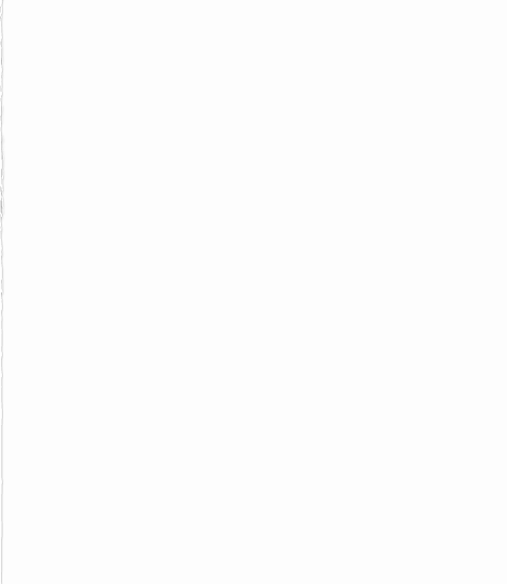
Overview
The project’s main aim is to develop a robot that can detect and navigate lanes on a UK road while obeying current UK traffic laws.

Slide 3
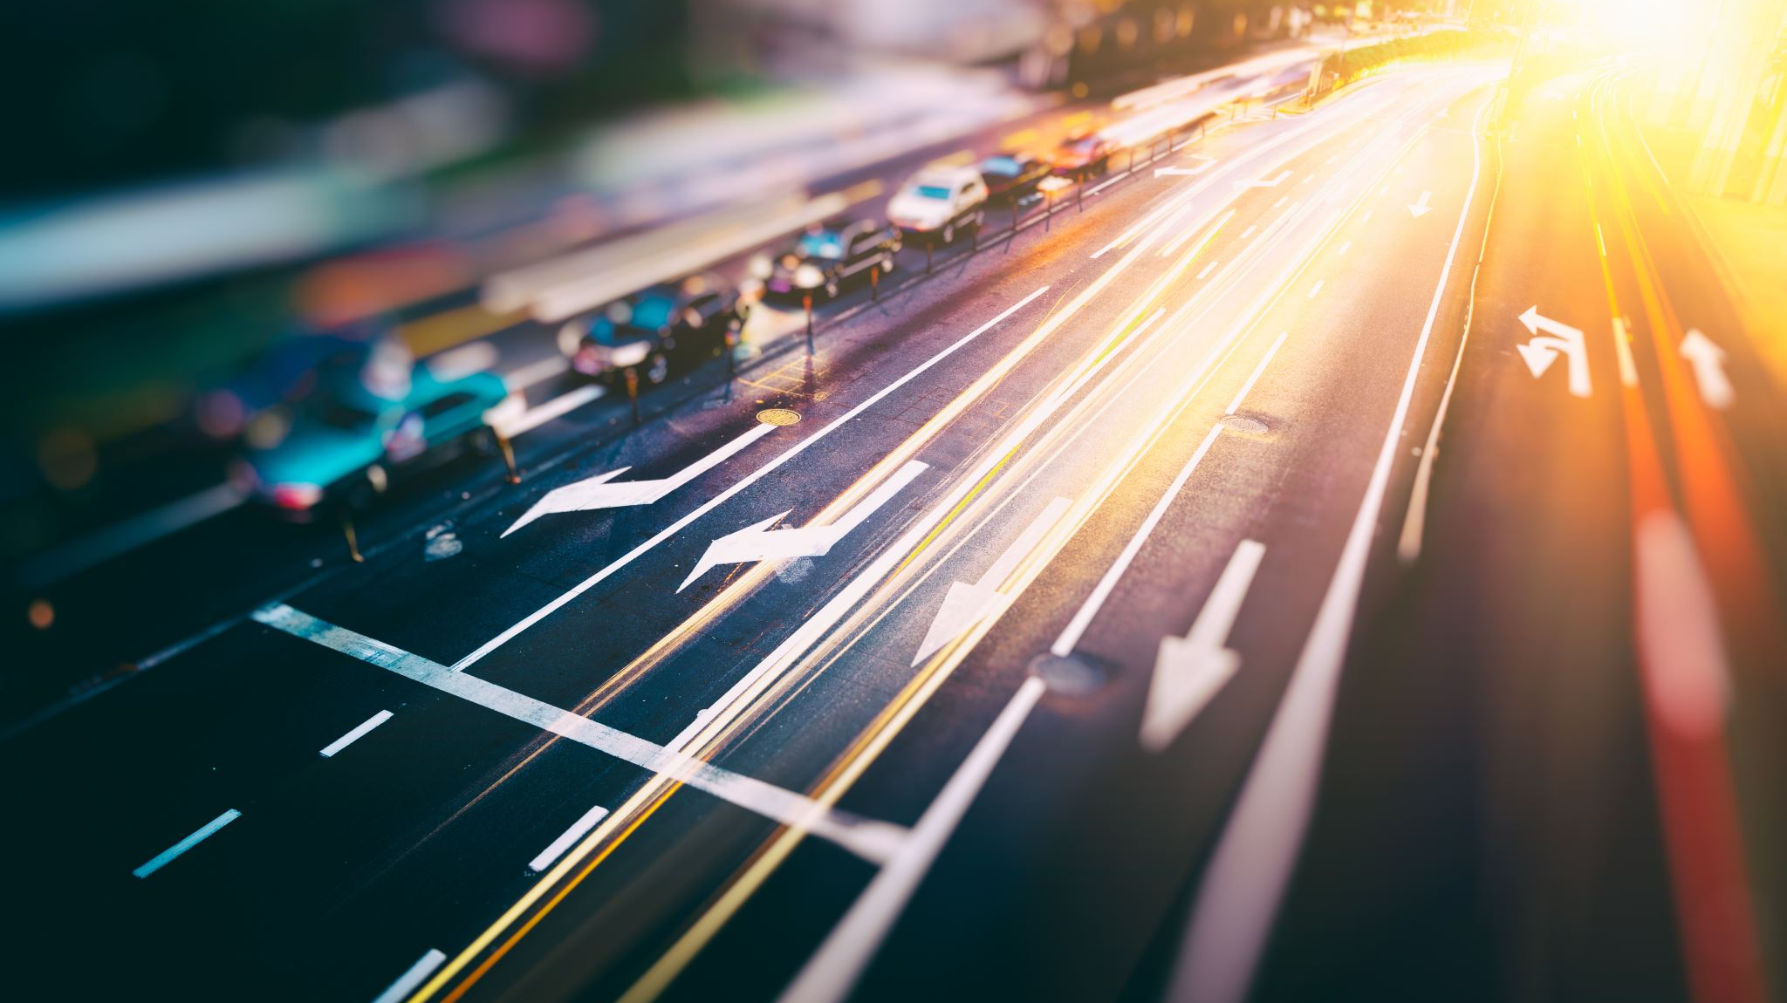
Background
Vehicles are becoming more and more autonomous.
Can detect:
Road signs.
Lanes.
Obstacles.
Can then give early warnings to the driver.
Notes:
Increasingly cars are becoming more autonomous, giving warnings for speed limit signs and controlling the speed of the vehicle. Meanwhile, fully autonomous cars are being developed and tested on the roads in a variety of situations.

Slide 4

Benefits of Going Autonomous
Fully autonomous cars have recently begun to be developed.
Goals:
Improving safety.
Improving traffic efficiency.
Cost saving.
Notes:
Fully autonomous cars have recently begun to be developed by a good number of companies: - Tesla
- Google
Improving safety:
- Predictable.
- Eliminate Human error.
- Prevention of accidents.
Improving traffic efficiency:
- Communication with each other.
- Travel at optimized distances from each other.
- Find best/fastest route.
- Eliminate bumper to bumper traffic jams.
Cost saving:
- Reduction in accident related costs.
- More efficient transportation.
- Better fuel economy.
There are, however, many problems surrounding autonomous cars and my project started to explore some of the complexities associated with lane detection and following.

Slide 5
Analysis
Tackle issues surrounding lane detection using:
A simple robot as a stand-in vehicle.
Simulated road environment.
A ROS based program using computer vision techniques.
Notes:
The project aimed to tackle the issues surrounding lane detection, and the adjustment of a driving behaviour to accurately follow the detected lane.
The main goal of this project was the development a Robot Operating System (ROS) based program to work with Turtlebot3; a relatively simple robot inside a simulated environment but with the potential for it to be transferred to a physical robot or to be adapted for use inside a vehicle.

Slide 6

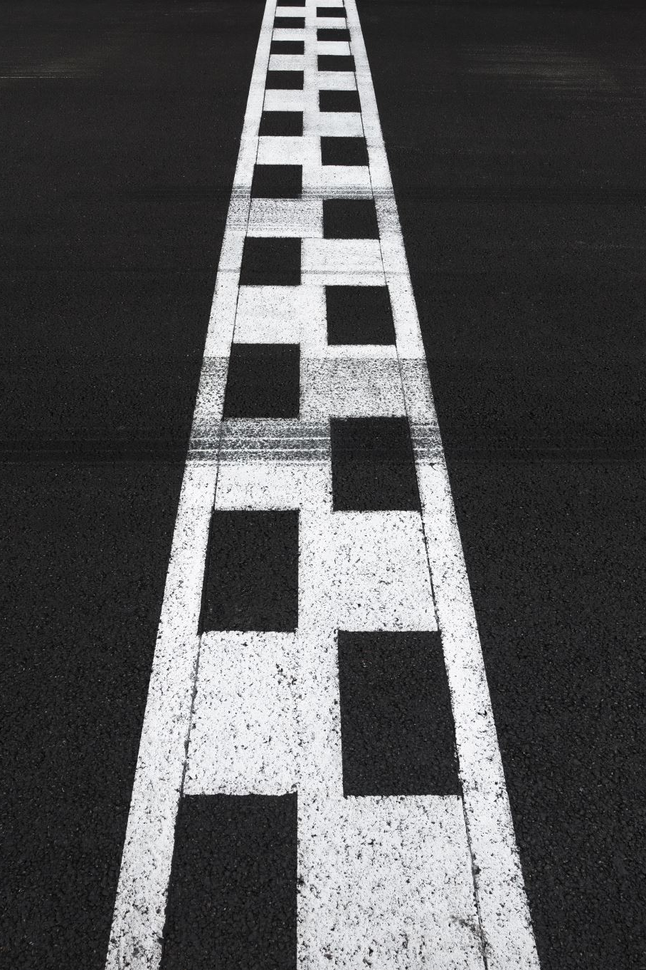
Analysis – Project Goals
Create
Simulated road environment.
Develop
Algorithm for detection of road markings.
Develop
Algorithm to calculate edges of the lane.
Develop
Algorithm to calculate center of detected lane.
Develop
Driving behavior to follow center of lane.
Notes:
1. Create sim:
- Develop road model.
- Create launch files.
2. Detect road markings: - Investigate some existing systems for inspiration.
3. Calc edges of lane:
- Use data from previous to detect the size/shape of lane ahead of robot.
4. Calc centre of lane:
- Use lane edges to calc lane centre.
5. Driving:
- Use lane centre to drive accurately along road.
I arrived at this list of objectives based on what I believe is achievable in the time available for this project.

Slide 7

Project Methodology
Agile Scrum:
Designed for software development projects.
Adaptable.
Incremental development process.
Notes:
I chose to use an Agile Scrum approach for my project.
Designed for software development:
- Ideal for my project, as my project will not include the development of anything physical.
Adaptable:
- Easy to adjust to my exact needs.
Incremental development:
- Consists of sprints to complete specific goals.
- Allowed me to concentrate all my efforts in one specific area.

Slide 8
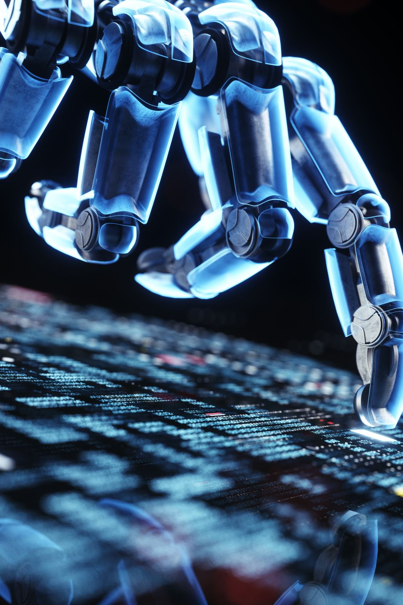
Technologies Involved
Robot Operating System (ROS).
Gazebo.
OpenCV.
GitHub.
Turtlebot3.
C++.
Notes:
ROS:
This the middleware that control communication between my program and the robot.
Uses a publisher/subscriber system.
Gazebo:
Program used to run the simulated environment.
OpenCV:
Image processing library.
Used in the program for processing the live images from the robot.
GitHub:
Version control.
TurtleBot3:
Robot model used for the project.
Simple design, perfect for my project.
C++:
Project was developed in C++.
Chose this over Python because I have more experience with it/more confident with it.

Slide 9
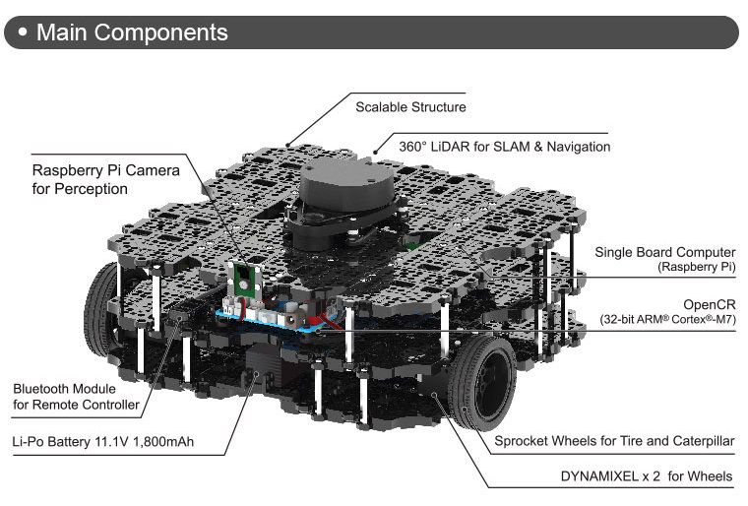
Turtlebot3 (Waffle Pi)
Simple design.
Has everything I need to complete the project.
Easy to drive.
Notes:
Simple design:
- No clutter.
- Forward facing camera can be used for lane detection.
- Easy driving, good turning circle even at low speeds.

Slide 10
Preparation
Taught myself to use OpenCV.
Researched some existing systems.
Researched available robots.
Notes:
OpenCV:
- Did not have any previous experience implementing OpenCV.
- Images from ROS needed to be converted to OpenCV image using CV_BRIDGE library.
- Chose to implement this in C++ over Python.
Existing Systems:
- ‘Automatic driving on Ill-defined roads: An adaptive, shape constrained, colour-based method’ (Ososinski and Labrosse, 2013)
- Accurate, but very complex.
- A similar approach wouldn’t be possible in project time span.
Available robots:
- Turtlebot3 was selected.
- Other robots were more complex and introduced a lot of unneeded features/clutter.

Slide 11
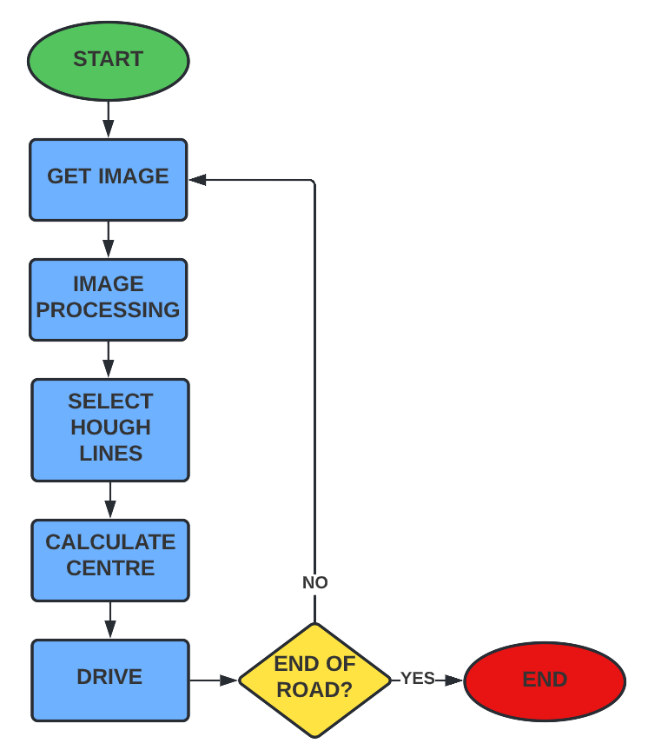
Overall Design
Relatively simple overall design.
Flow chart shows how the system functions.
3 major areas:
Image Processing.
Selection of Hough Lines.
Calculation of center line & driving.
Notes:
Get image from robot.
Image proc.
Select Hough lines.
Calc centre.
Drive.
Loop if not at end of road.

Slide 12
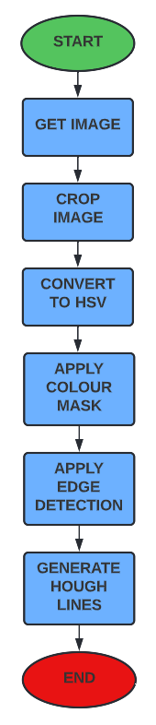
Image Processing
This flowchart depicts the 6 steps that the image processing algorithm takes.
Image processing function runs in separate, parallel thread.
Notes:
Get image
Convert image to useable opencv image using CV_BRIDGE library.
Crop.
Convert to hsv.
Apply mask.
Apply edge detector.
Generate hough lines.
Runs in separate thread to stop blocking of program.
Image proc is very intense especially since this is being done on a live image feed looping as fast as possible.

Slide 13
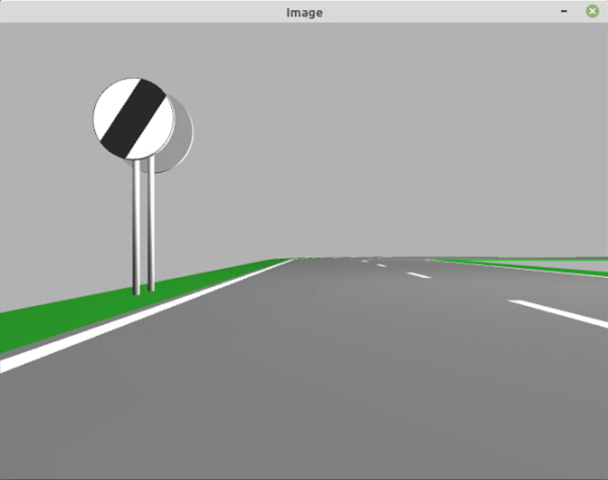
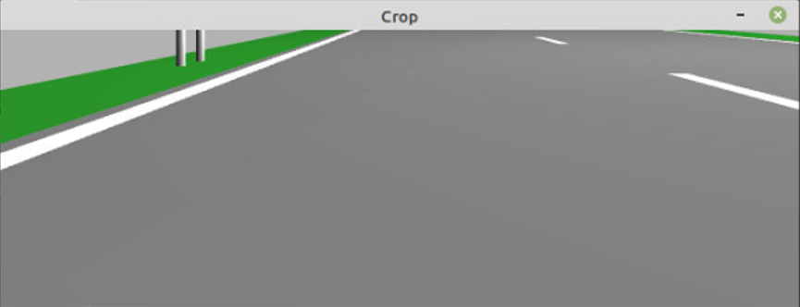
Crop Image
Notes:
- The top half of the image is not useful, and would only complicate the lane detection.

Slide 14
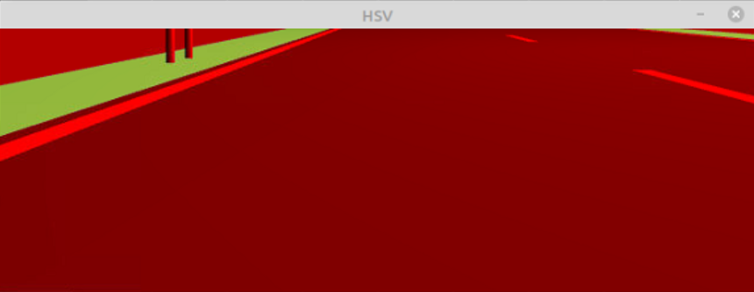

Convert to HSV
Notes:
- Makes for easier colour masking

Slide 15
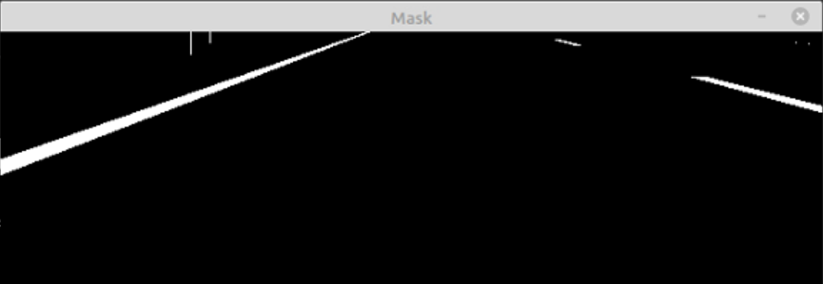
Colour Mask
Notes:
- Mask the image so only the white lines are visible.

Slide 16
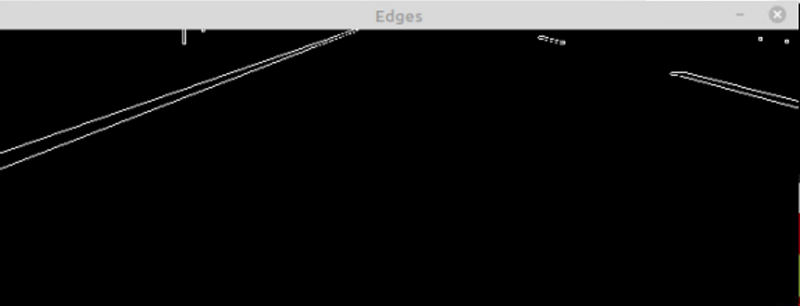
Canny Edge Detection
Notes:
- Detects edges, creates point cloud that can be used by hough lines generator

Slide 17
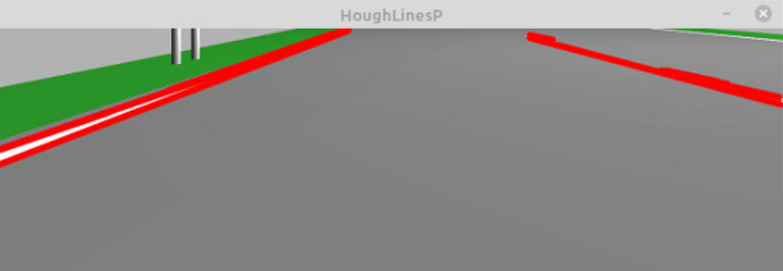
Hough Lines
Notes:
Detects straight lines from point cloud (canny edge detector image).
Draws detected lines onto clone of cropped image so its easier for observer to identify.

Slide 18
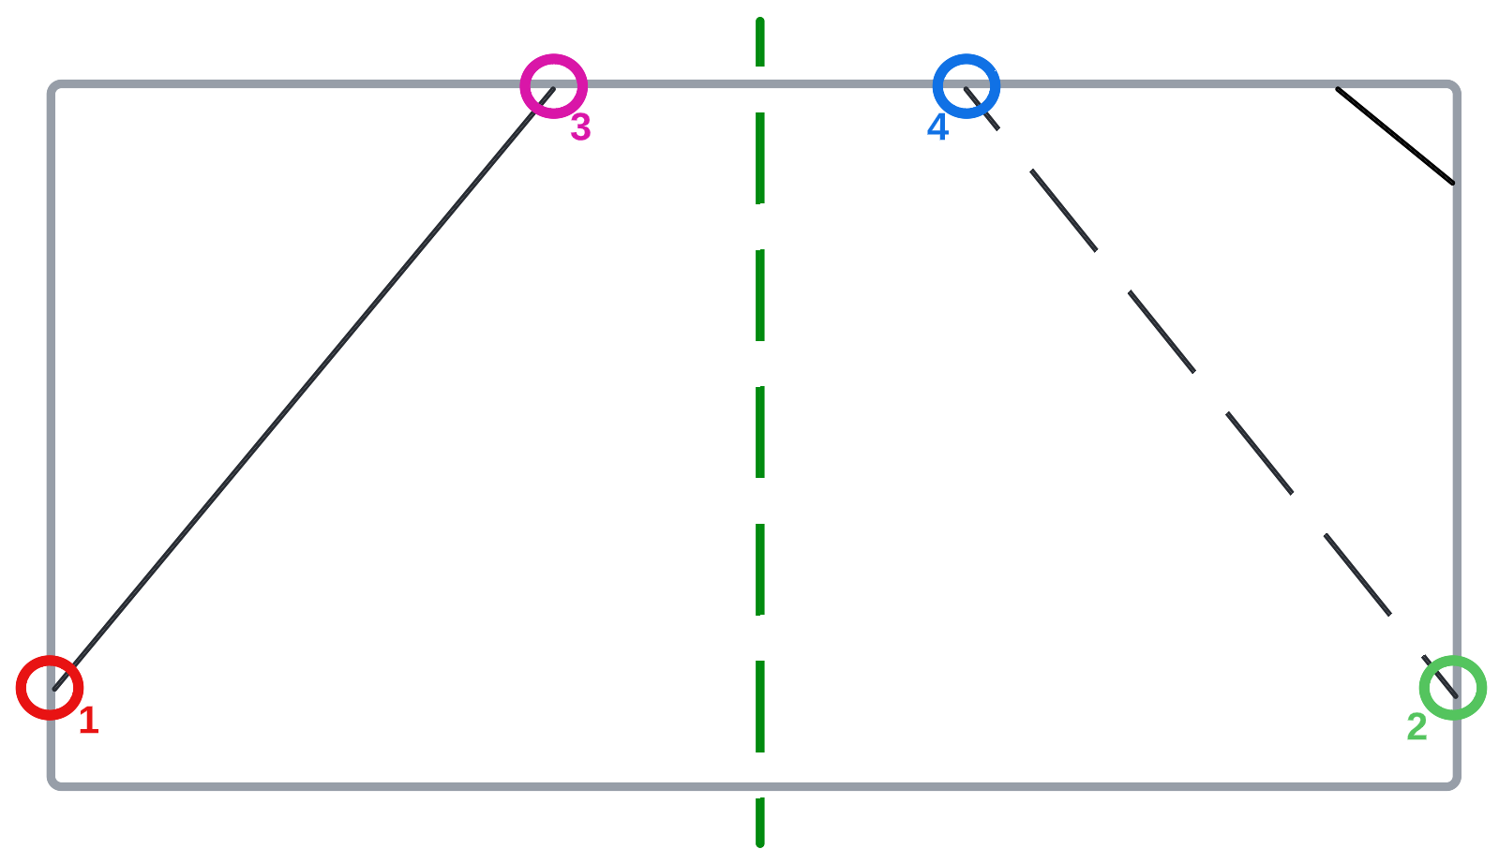
Selection of Appropriate Hough Lines
The Hough lines generation creates a lot of lines.
Each line has start & end coordinates.
Algorithm will determine best points to use for lane tracking.
Notes:
Hough lines stored in vector
Each line has 2 points (START & END). Each point has 2 values (X & Y).
Algorithm sorts through vector and selects the best points to use as markers for the edges of the lane based on their coordinates.
Once algorithm has determined best points, it will draw left and right line on image to represent the edges of the lane.

Slide 19
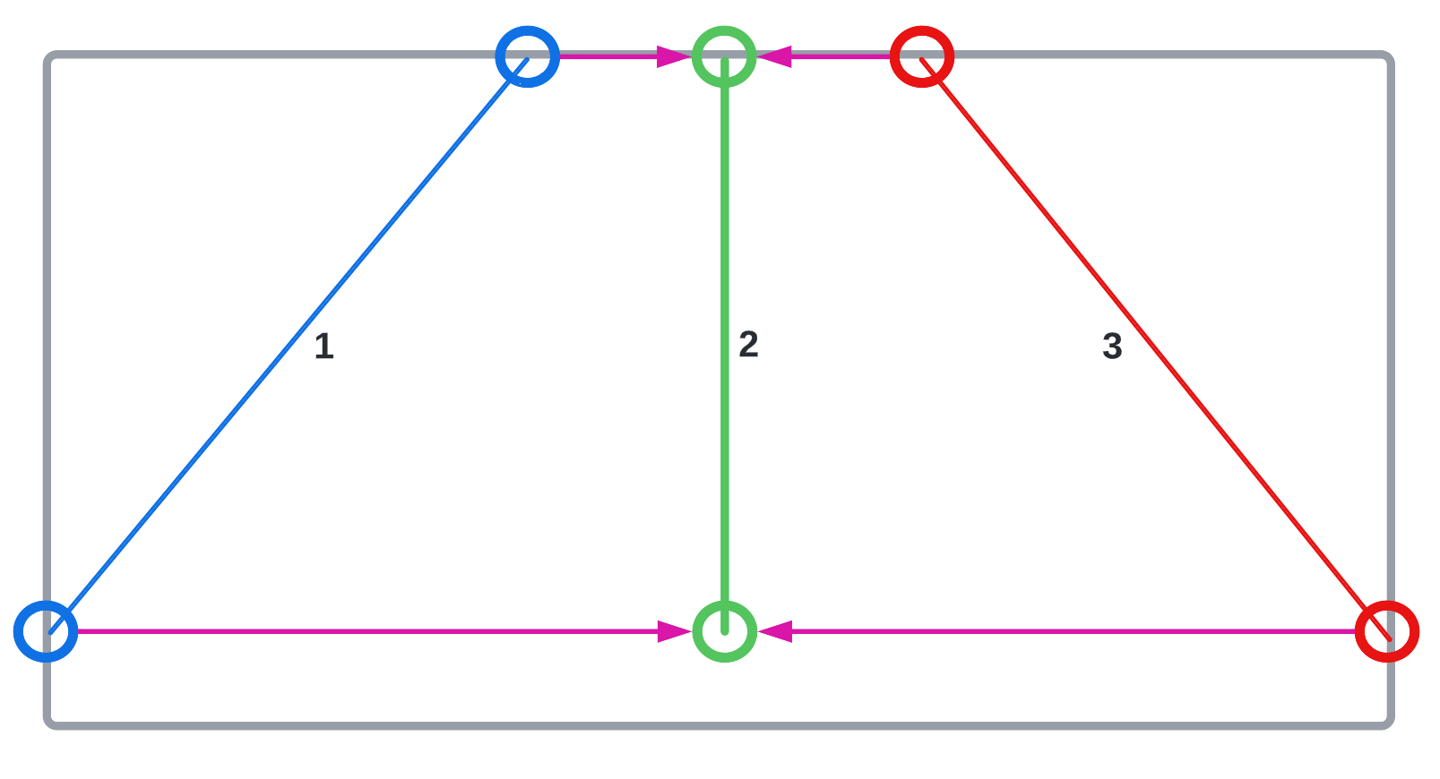
Calculate Centre of Lane
Calculates the centre of the lane ahead of robot.
Uses the most appropriate Hough line points calculated in previous step.
Notes:
This short algorithm is used to calculate the centre of the lane ahead of the robot.
Makes use of the Hough line points found in the previous step.
This centre line can then be passed to the driving function so that the robot may accurately drive along the road.

Slide 20
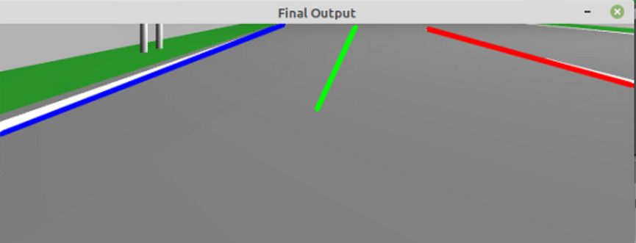
Final Output
Notes:
Final image output showing the detected left and right sides of the lane as well as the calculated centre of the lane.
Ready for robot to drive.

Slide 21
Driving
Uses the centre line’s coordinates on the image to determine if the robot should turn left or right or continue driving straight.
Every time the program updates the image from the robot, the driving function also updates.

Slide 22
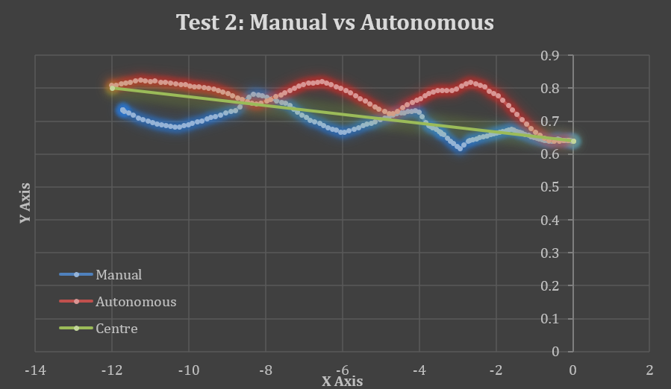
Testing
Created separate program to log the robot position inside Gazebo.
Ran 2 times, one manually driving and one autonomous.
Overlaid results of both tests compared to each other, and the actual centre of lane.
Notes:
This is testing example showing the comparison of manual driving and autonomous driving, with centre of lane shown in green.

Slide 23
Technical Issues Encountered
Failed Lane Detection Technique.
Application of colour mask.
Tuning parameters of Hough lines and Canny edge detector.
Image processing was too intense & splitting into separate thread.
Development of Hough lines selection algorithm.
Driving function was too sensitive.
Notes:
Failed image proc design:
Used 2 image perspective warps, left & right.
Created 2 cropped, warped images.
Tried to track lines inside warped images, could track left & right separate.
Failed horrible when approaching any form of corner/when robot was slightly misaligned with centre of lane.
BGR colour space not easy to mask:
Solution: convert to HSV colour space.
Tuning parameters of image proc functions:
Hough lines & Canny edge detector.
Made use of OpenCV trackbars.
Split image proc into separate thread:
Image proc was far too intensive.
Blocked other program functions from running, caused major problems while running in single thread.
Splitting this into a separate, parallel thread was the only option as it was just too intensive to run on a live video feed inside a single thread.
Hough lines selection:
Became very complicated and hard to follow very quickly.
Current solution is not perfect efficiency wise, and has room for improvement.
Went through a lot of changes throughout the project in order to improve reliability.
Difficult to select the correct lines sometimes it can get confused. Added some protection to help prevent it from selecting points that are too close to each other.
Driving function:
Was too sensitive, robot would react too quickly to the line updating and would cause the robot to vibrate left & right.
Added deadzone so that driving function wouldn’t try to over correct the robot as soon as the alignment wasn’t perfect.
Driving function would get blocked by image processing, causing robot to crash or veer off road. This was fixed by multi threading.
Added some checks to make sure both left & right lines were detected before deciding on where to steer. Improved cornering when robot may lose track of lines.

Slide 24

Live Demo

